Slide 1
Azure Face API with Real-Time Message Broker(RTMB) Service and Plotly JS
Tadesse, Wonde

Slide 2
Topics
Part 1. Azure Face API
Quick overview of Azure Cognitive Services and Azure Face API
Detail overview of Azure Face API.
Explaining Azure Face API .NET library.
Part 2. Realtime Message Broker (RTMB) Service
Overview of SignalR.
Usage of SignalR in a RESTful service.
How to send/receive result set data in real time.
Where and how it fits in Azure Face API.
Part 3. Azure Face API Photo and Chart viewer
Usage of Plotly JS framework for Charts.
View photo that is identified by Face API in real time.
Part 4. Demo and resource links

Slide 3
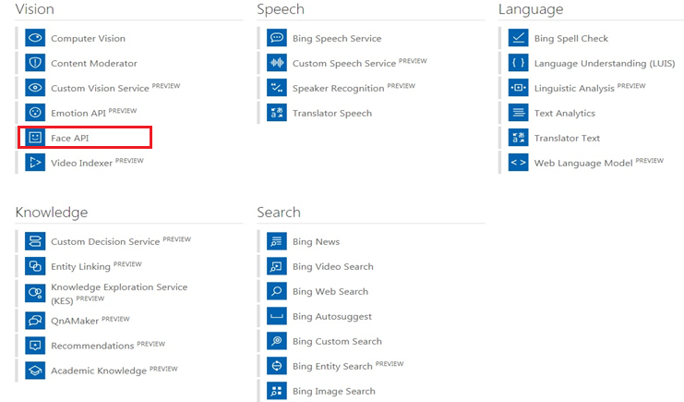
Part 1: Azure Cognitive Services – Azure Face API
What is Azure Cognitive Services ?
Set of services focus on intelligent algorithms.
These services are categorized as Vision, Speech, Language, Knowledge and Search.

Slide 4
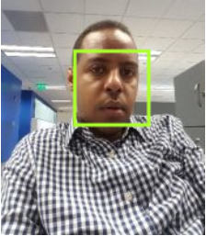
Continuation
What is Azure Face API ?
Is a set of API that helps to Detect, Identify , Verify, Group and tag faces on photos.
Face Detection – detect faces with a given image and get back face rectangles.
Presents face features based on Machine - Learning predication.
Face features attributes consists of Age, Emotion, Gender, Smile and many more attributes.
 | { "FaceId": "b6876343-7494-48c6-8b37-9f3bb8a2c2ff", "FaceRectangle": { "Width": 63, "Height": 63, "Left": 63, "Top": 75 }, "FaceLandmarks": null, "FaceAttributes": { "Age": 32.4, "Gender": "male", "HeadPose": { "Roll": 1, "Yaw": 18.9, "Pitch": 0 }, "Smile": 0, "FacialHair": { "Moustache": 0.4, "Beard": 0.4, "Sideburns": 0.3 }, … }

Slide 5
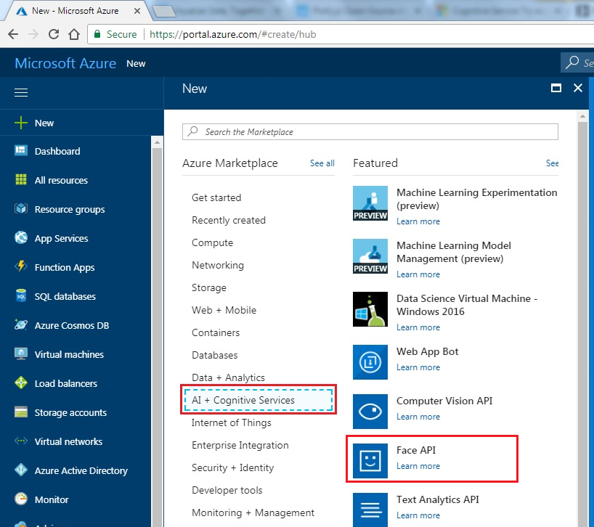
Continuation
How to create Azure Face API ?
By going to Azure Portal, selecting ‘AI + Cognitive Services’ resources section.
Selecting ‘Face API’ feature will enable us to create the API.

Slide 6
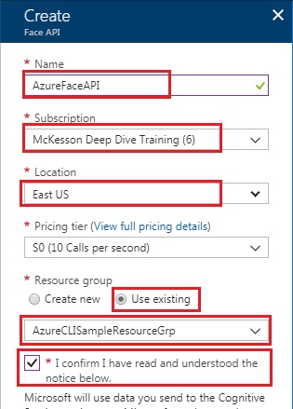

Continuation
By passing the necessary ‘Face API’ input we get the expected API

Slide 7
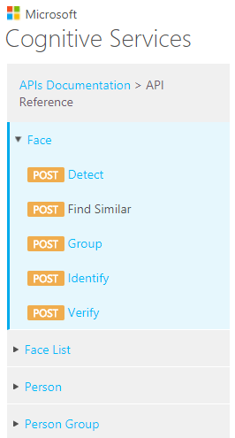
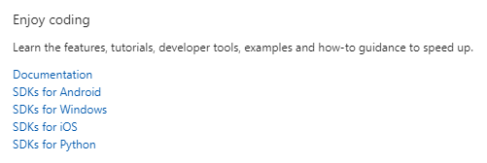
Continuation
Azure Face API has rich development resources and API references.
It’s also supports different programming language and platforms.
@wonde-tadesse

Slide 8
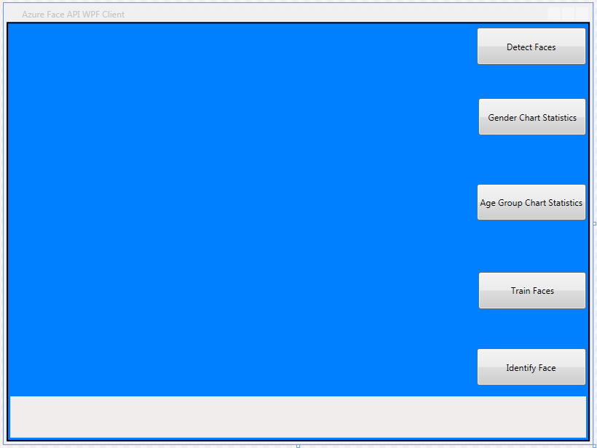

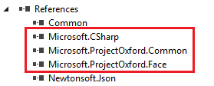
Continuation
Creating Azure Face API Client WPF solution by using Visual Studio 2017.
Adding Azure Face API related references from NuGet package.
After successful installation we see the references in Solution

Slide 9

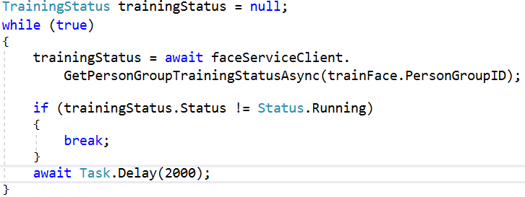
Continuation
Face Identification – identify faces with similar faces based on user provided data
AI adds set of photos to whom the photos belongs to.
AI then group those similar photos accordingly.
AI train the photos according to the given group.
Check the status of the AI training to make sure it’s completed.

Slide 10
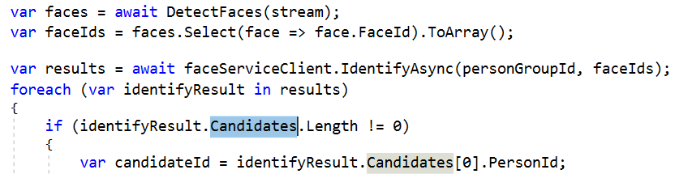
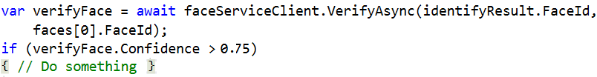
Continuation
When AI training completed, Face Identification can be performed.
Within a given photo, if a face is identified once of more of candidates will be returned.
Face Verification – identify the similarity of two faces and returns a confidence score
Confidence score is a value range from 0 – 1.
The high the score the better accuracy of image.
Face Grouping - organize faces with visual similarity.

Slide 11
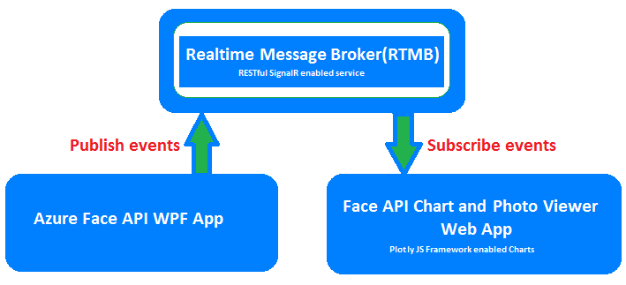
Part 2 : Real time Message Broker (RTMB)
What is Message Broker ?
“a message broker is an intermediary program module that translates a message from the formal messaging protocol of the sender to the formal messaging protocol of the receiver”
Wiki links - https://en.wikipedia.org/wiki/Message_broker
What is Real Time Message Broker ?
It’s a message broker service that transmit data from sender to receiver in real time fashion with the help of SignalR.

Slide 12
Continuation
SignalR is an API that helps a bi-direction real-time message communication between client-server apps.
SignalR wraps different well known client-server communication protocols as Unified framework.
These protocols are Long pooling, Server-Sent events, Web Sockets, Forever frame/Comet.
Long pooling – the communication is initiated by client waits until the server sends data to the client within the given time.
Server-sent events – as soon message completes server sent an event to the client along with the message.
Web sockets – a bi-directional message communication between client and server. Client as well as Server can initiate communication.
Forever frame/Comet – a communication established with a hidden frame html tag to send chunk of message to the client-server.
Realtime Message Broker is a REST based service that encapsulate SignalR functionality to increase the availability of message in real time.

Slide 13
Continuation
Where does Realtime Message Broker(RTMB) fits on Azure Face API ?
Publish Face API results at real time when Azure Face API completes its face analysis.
Message will be published in the form of JSON format.
Message subscriber parses JSON format string value and present as desired output.
Photo images published in the form of base64 encoded string format.
Message subscriber decodes the base64 photo data presents as needed.

Slide 14
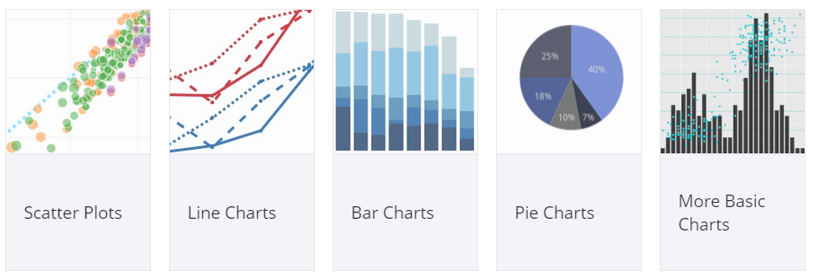
Part 3. Azure Face API Photo and Chart viewer
Present Azure Face API photo result set in the form of Chart and Photo
Results are presented in the web app.
Usage of Plotly JS framework to view charts.
Plotly is a high-level, declarative charting JS library.
It’s also free open source. https://github.com/plotly/plotly.js
Example

Slide 15
Part 4. Demo and resource links
YouTube links
2 minutes: https://www.youtube.com/watch?v=jMVeof-f_h0
15 minutes: https://www.youtube.com/watch?v=0-KxsNlgw_Y
15 minutes demo: https://www.youtube.com/watch?v=82sThT0N1FI
GitHub Repository with all artifacts
Slides : https://github.com/wondechala/AzureFaceAPISampleSlides
Reports : https://github.com/wondechala/AzureFaceAPISampleReport
Source code : https://github.com/wondechala/AzureFaceAPISample
Resources
Azure Face API documentation - https://azure.microsoft.com/en-us/services/cognitive-services/face/
SignalR related resources
https://www.codeproject.com/Articles/898992/RESTful-SignalR-Service
https://docs.microsoft.com/en-us/aspnet/signalr/overview/getting-started/introduction-to-signalr
Plotly JS framework - https://plot.ly/javascript/

